Slide 1
COS 326 Database Systems
Lecture 11
Semi-Structured Data and XML (3)
Chapter 13 (7th edition)
Tuesday 27 August 2024

Slide 2
In this lecture
Semi-structured data (continued)
XQuery
XPath expressions (last lecture)
FLWOR queries
Files available on ClickUP
staff_list.xml and nok.xml

Slide 3
Recap
XML Languages
XPath: path expressions
XQuery
Introduction to BaseX
Writing XPath expressions in BaseX
Files available on ClickUP
XML file for this lecture: staff_list.xml
© Pearson Education Limited 1995, 2005

Slide 4
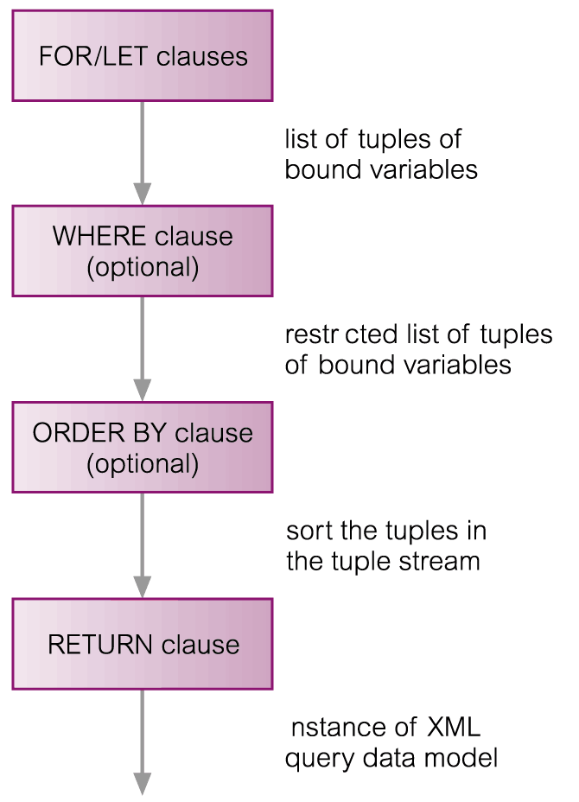
XQuery – FLWOR Expressions
FLWOR (“flower”) expression construction:
(1) starts with one or more FOR or LET clauses (any order)
(2) followed by optional WHERE clause
(3) optional ORDER BY clause
(4) required RETURN clause
FOR forVar IN inExpression
LET letVar := letExpression
[WHERE filterExpression ]
[ORDER BY orderSpec ]
RETURN expression
© Pearson Education Limited 1995, 2005

Slide 5
FLWOR Expressions
FOR e.g. for $S in //STAFF
iteration: associates variable $S with each expression value
result is tuple stream
LET e.g let $sal := 30000
binds one or more variables to one or more expressions
without iteration (single binding for each variable)
FOR forVar IN inExpression
LET letVar := letExpression
[WHERE filterExpression]
[ORDER BY orderSpec]
RETURN expression

Slide 6
FLWOR Expressions
WHERE e.g. where $S/SALARY > 10000
one or more conditions to restrict tuples generated by FOR and LET (optional)
FOR forVar IN inExpression
LET letVar := letExpression
[WHERE filterExpression]
[ORDER BY orderSpec]
RETURN expression

Slide 7
FLWOR Expressions
ORDER BY e.g. order by $S/STAFFNO descending
order of the tuple stream
determines order in which RETURN clause is evaluated
RETURN e.g return $S
evaluated once for each tuple in tuple stream
results concatenated to form final result
FOR forVar IN inExpression
LET letVar := letExpression
[WHERE filterExpression]
[ORDER BY orderSpec]
RETURN expression
© Pearson Education Limited 1995, 2005

Slide 8
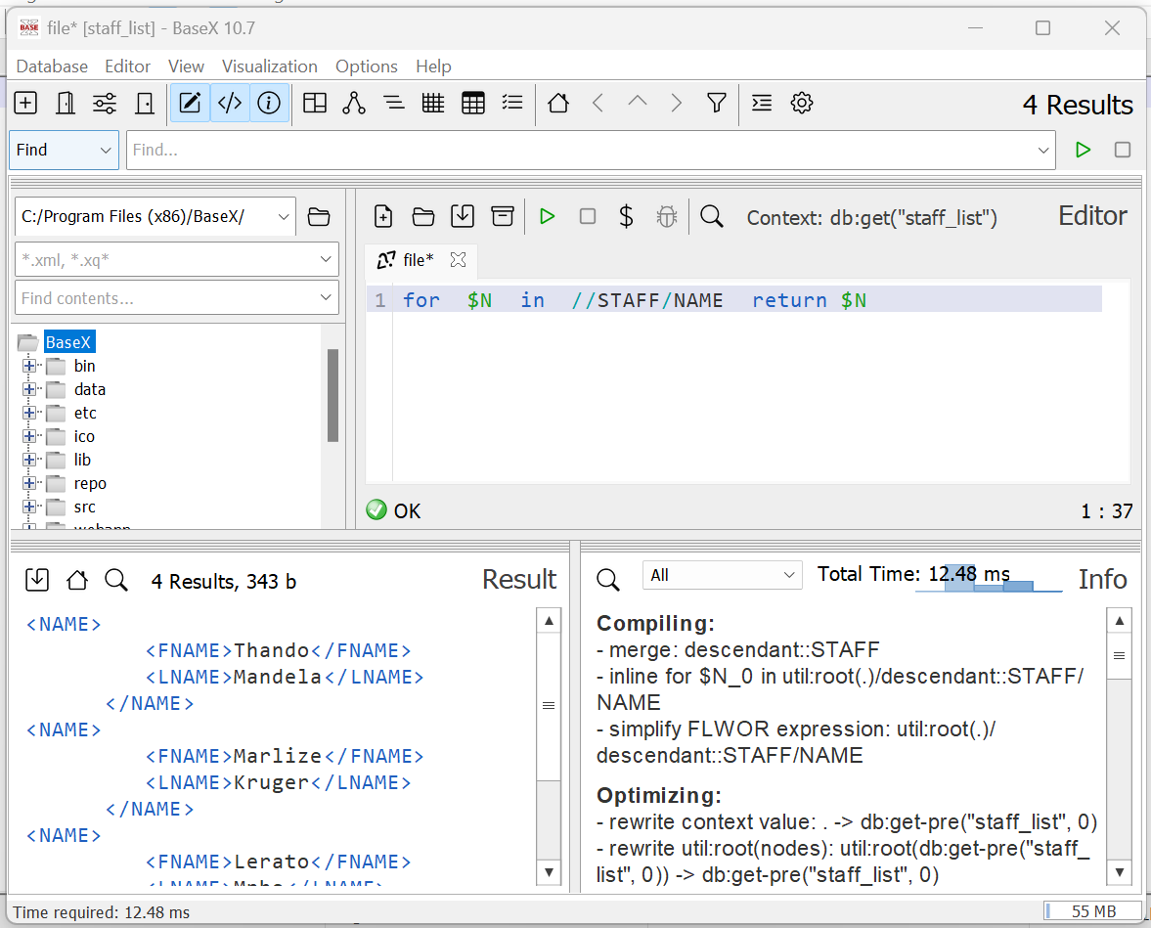
Example 1 – XQuery FLWOR Expressions in BaseX 11.2
List the names of all staff
for $N in //STAFF/NAME return $N
Note:
Must use lowercase for:
FOR, LET, WHERE, RETURN, etc.
© Pearson Education Limited 1995, 2005

Slide 9
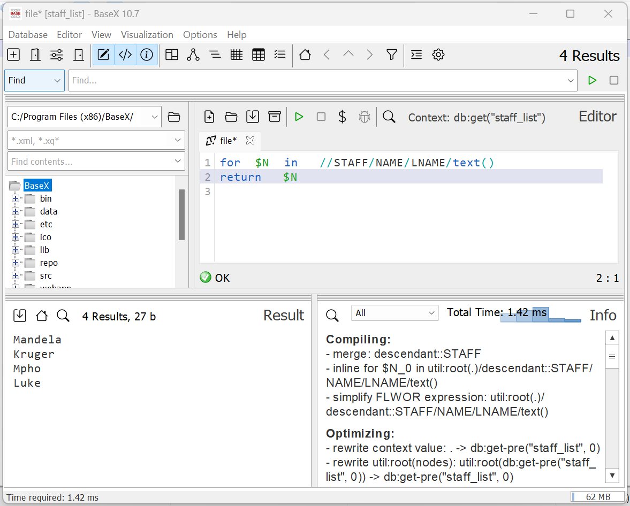
Example 2 – XQuery FLWOR Expressions in BaseX 11.2
List the last names of all staff
for $N in //STAFF/NAME/LNAME/text()
return $N
Note:
You can use the text() function to extract values
© Pearson Education Limited 1995, 2005

Slide 10
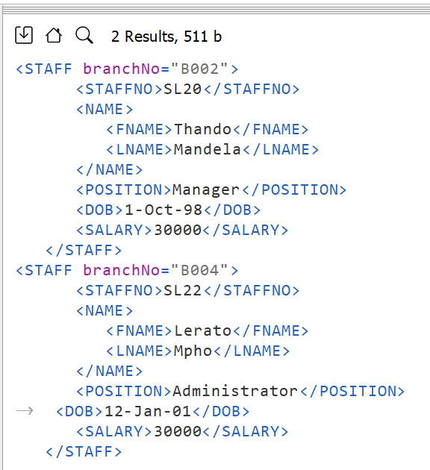
Example 3 – XQuery FLWOR Expressions
List staff with salary = R30,000
let $SAL := 30000
return //STAFF[SALARY = $SAL]
**Note:
var names are case sensitive
other operators:
‘eq’, ‘ne’, ‘lt’, ‘le’, ‘gt’, ‘ge’
value comparison operators
© Pearson Education Limited 1995, 2005

Slide 11
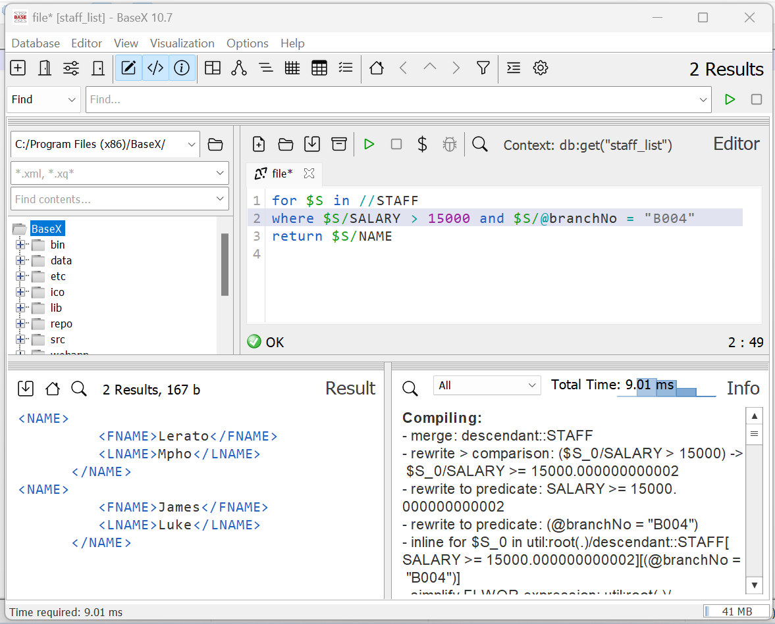
Example 4 – XQuery FLWOR Expressions
Find staff name at branch
B004 with salary > R15,000
for $S in //STAFF
where $S/SALARY > 15000 and $S/@branchNo = "B004"
return $S/NAME
© Pearson Education Limited 1995, 2005

Slide 12
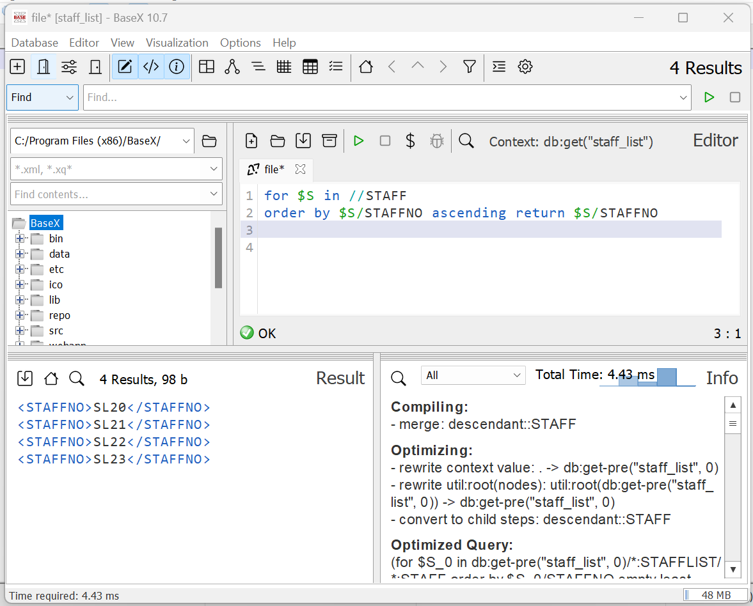
Example 5 – XQuery FLWOR Expressions
List staff numbers of all staff
in ascending order of staff number
for $S in //STAFF
order by $S/STAFFNO ascending return $S/STAFFNO

Slide 13
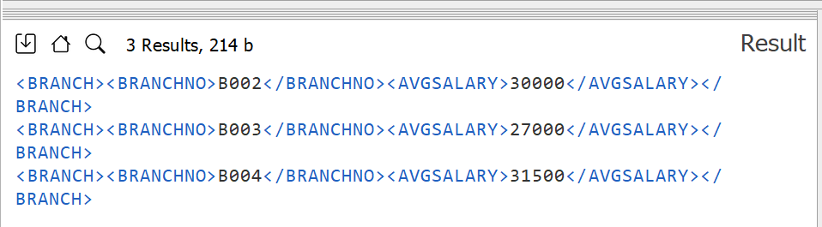
Example 6 – XQuery FLWOR Expressions
List each branch office and average salary at branch
for $B in distinct-values(//@branchNo)
let $avgSalary :=
avg(//STAFF[@branchNo = $B]/SALARY)
return
<BRANCH>
<BRANCHNO>{$B }</BRANCHNO>
<AVGSALARY>{ $avgSalary }</AVGSALARY>
</BRANCH>
Functions for aggregates are: avg, etc.
Homework
© Pearson Education Limited 1995, 2005

Slide 14
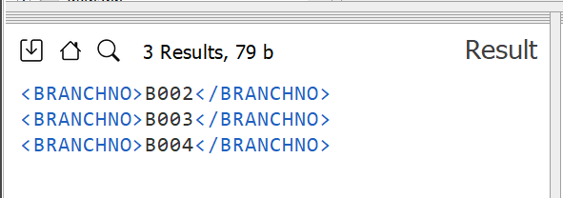
Example 7 – XQuery FLWOR Expressions
List branches with at least one member of staff with
salary > R15,000
for $B in distinct-values(//@branchNo)
let $S := //STAFF[@branchNo = $B]
where some $sal in $S/SALARY
satisfies ($sal > 15000)
return <BRANCHNO>{ $B}</BRANCHNO>
sub-query
some: existential qualifier
every: universal qualifier

Slide 15
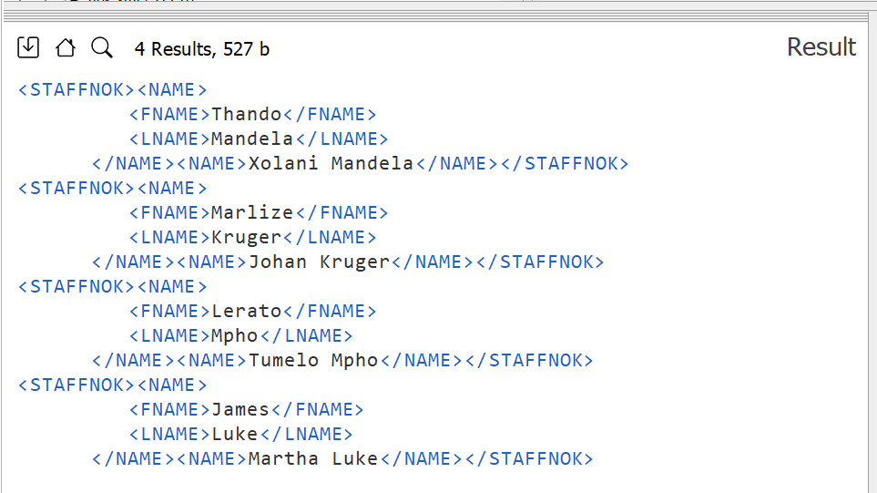
Example 1 – Joining Two Documents
List names of staff and
names of their next of kin
for $S in //STAFF,
$NOK in //NOK
where $S/STAFFNO = $NOK/STAFFNO
return
<STAFFNOK>
{ $S/NAME, $NOK/NAME }
</STAFFNOK>

Slide 16
Example 2 – Joining Two Documents
List names of staff and names of their next of kin
for $S in //STAFF
return <STAFFNOK>
{ $S/NAME }
{ for $NOK in //NOK
where $S/STAFFNO =$NOK/STAFFNO
return $NOK/NAME }
</STAFFNOK>
Correlated
sub-query
© Pearson Education Limited 1995, 2005

Slide 17
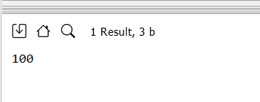
Example 3 – User-Defined Function (1)
Simple arithmetic function in BaseX
FUNCTION DEFINITION:
let $mult := function($x, $y) {$x * $y}
return $mult(10,10)
FUNCTION CALL:
© Pearson Education Limited 1995, 2005

Slide 18
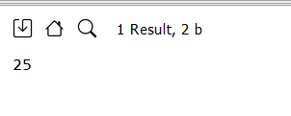
Example 4– User-Defined Function (2)
Simple arithmetic function in BaseX
FUNCTION DEFINITION:
let $f := math:pow#2
return $f(5, 2)
FUNCTION CALL:
Built-in functions:
Reading for the student
© Pearson Education Limited 1995, 2005

